Slide 1

Green Pace

Slide 2
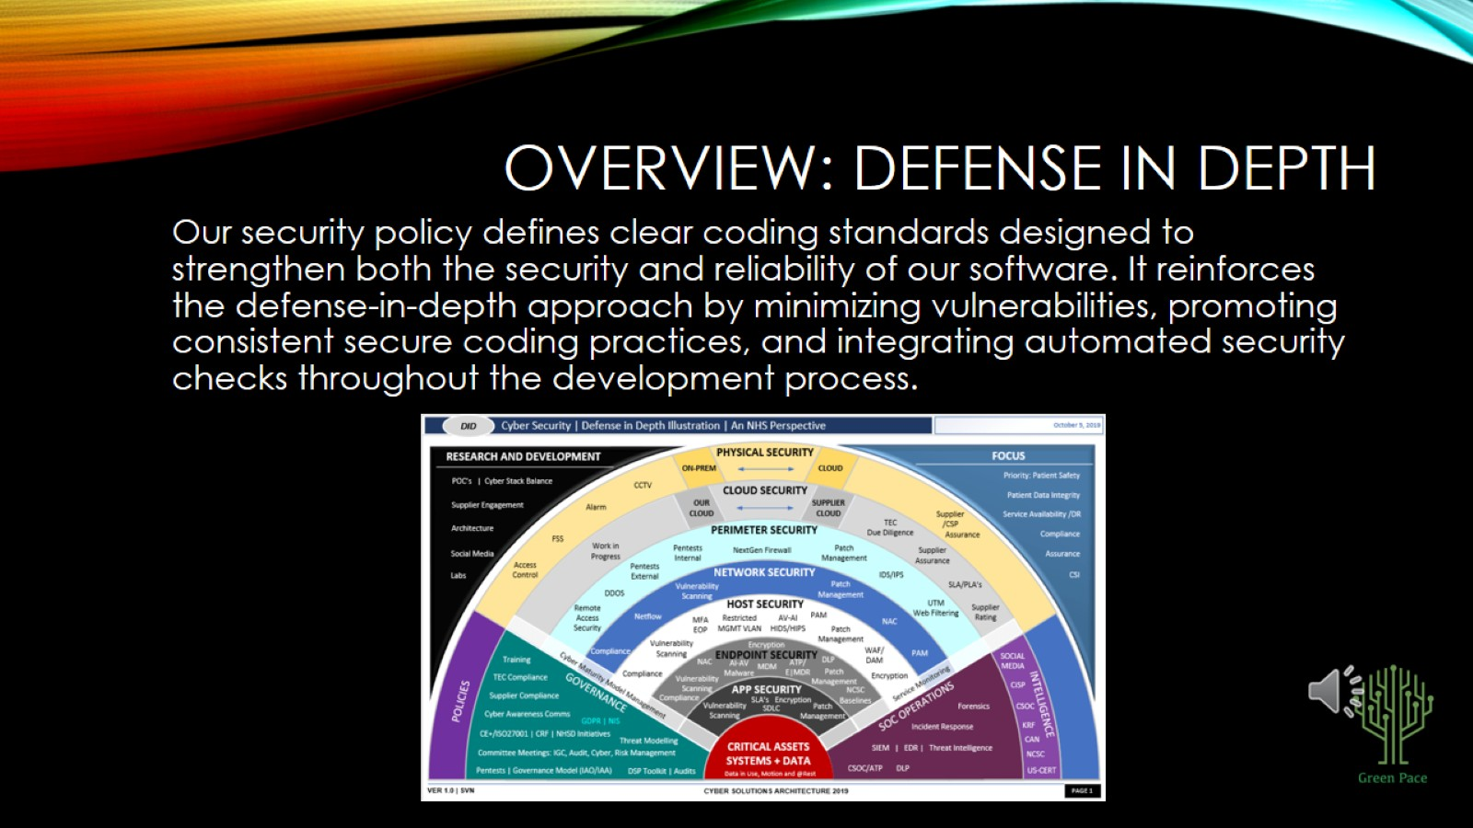
OVERVIEW: DEFENSE IN DEPTH

Slide 3
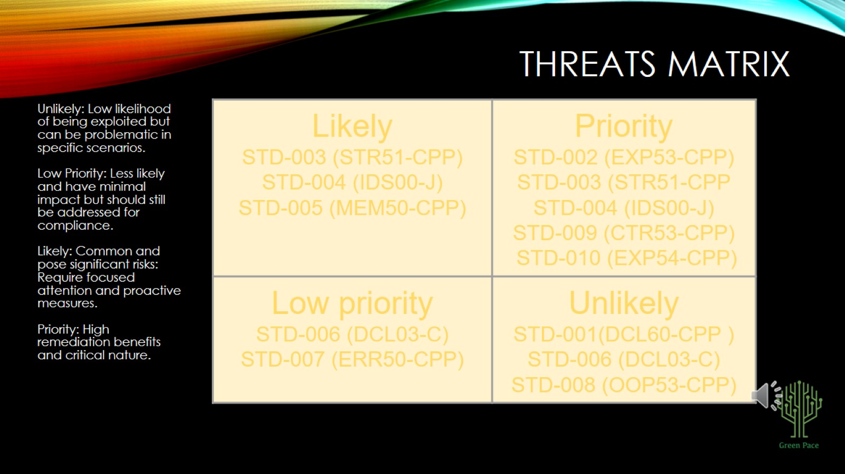
THREATS MATRIX

Slide 4
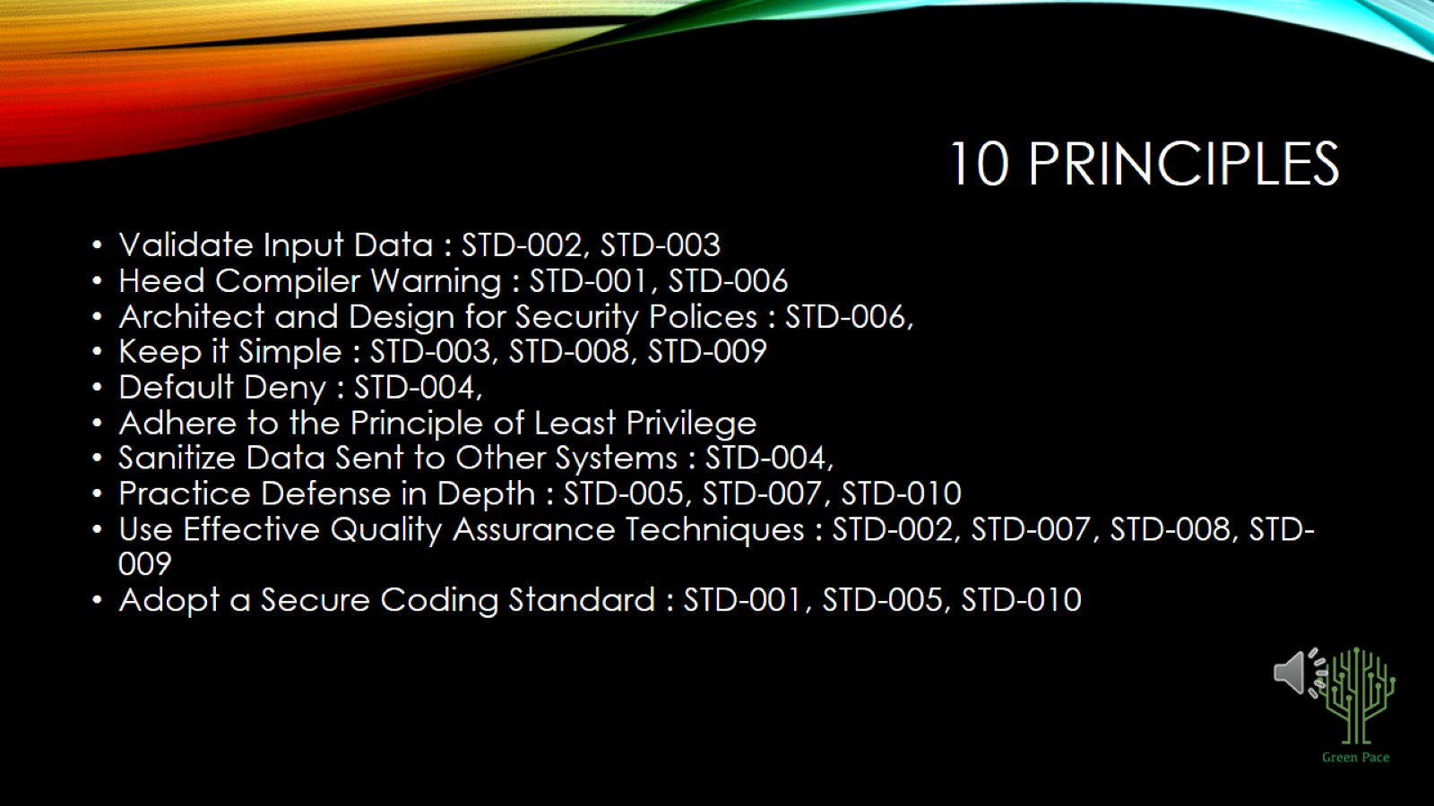
10 PRINCIPLES

Slide 5
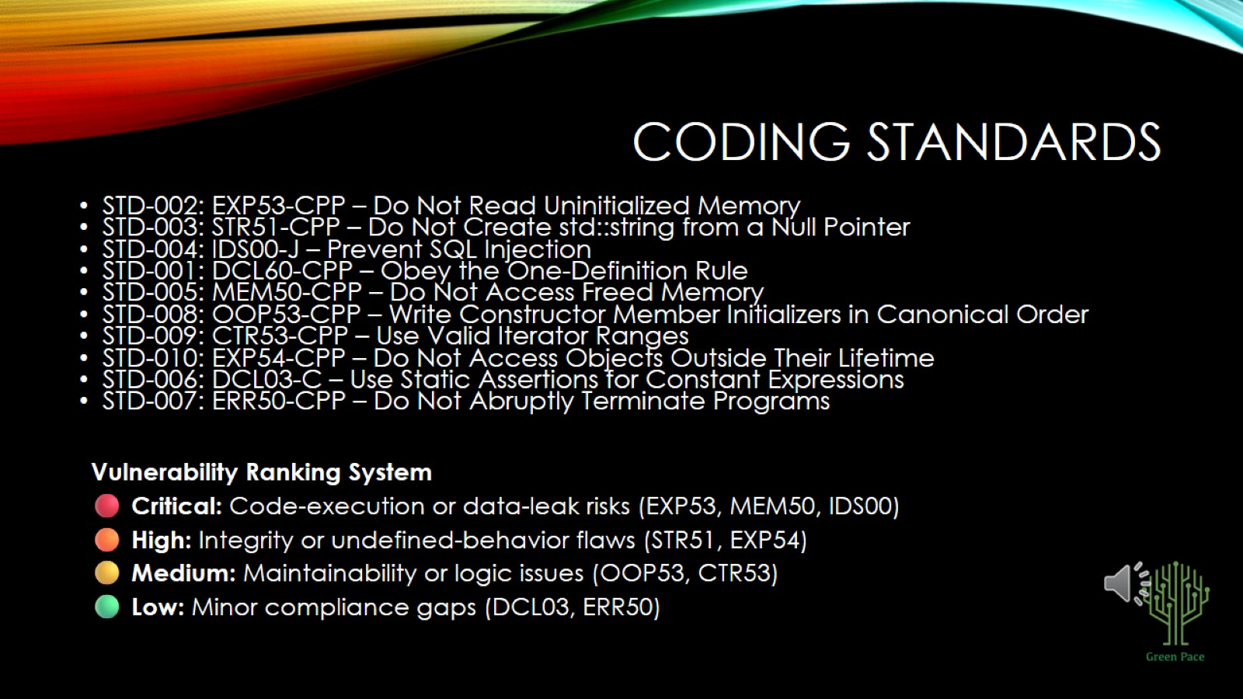
CODING STANDARDS

Slide 6
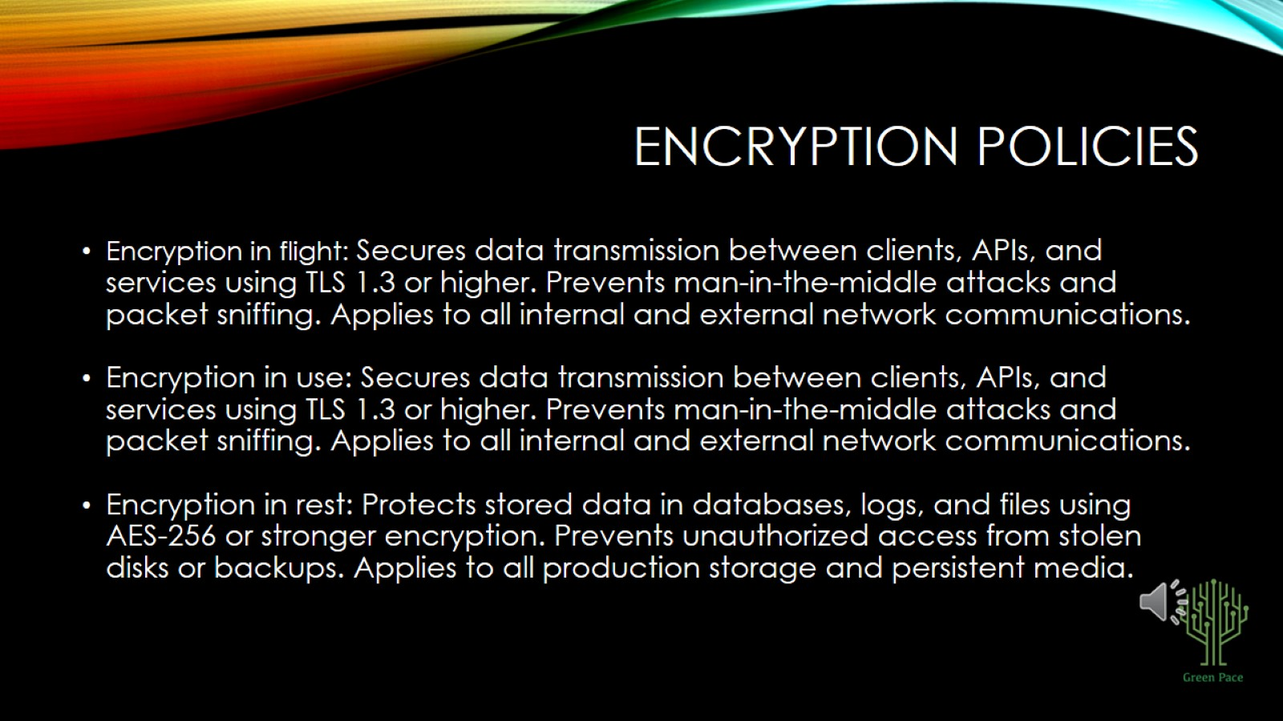
ENCRYPTION POLICIES

Slide 7
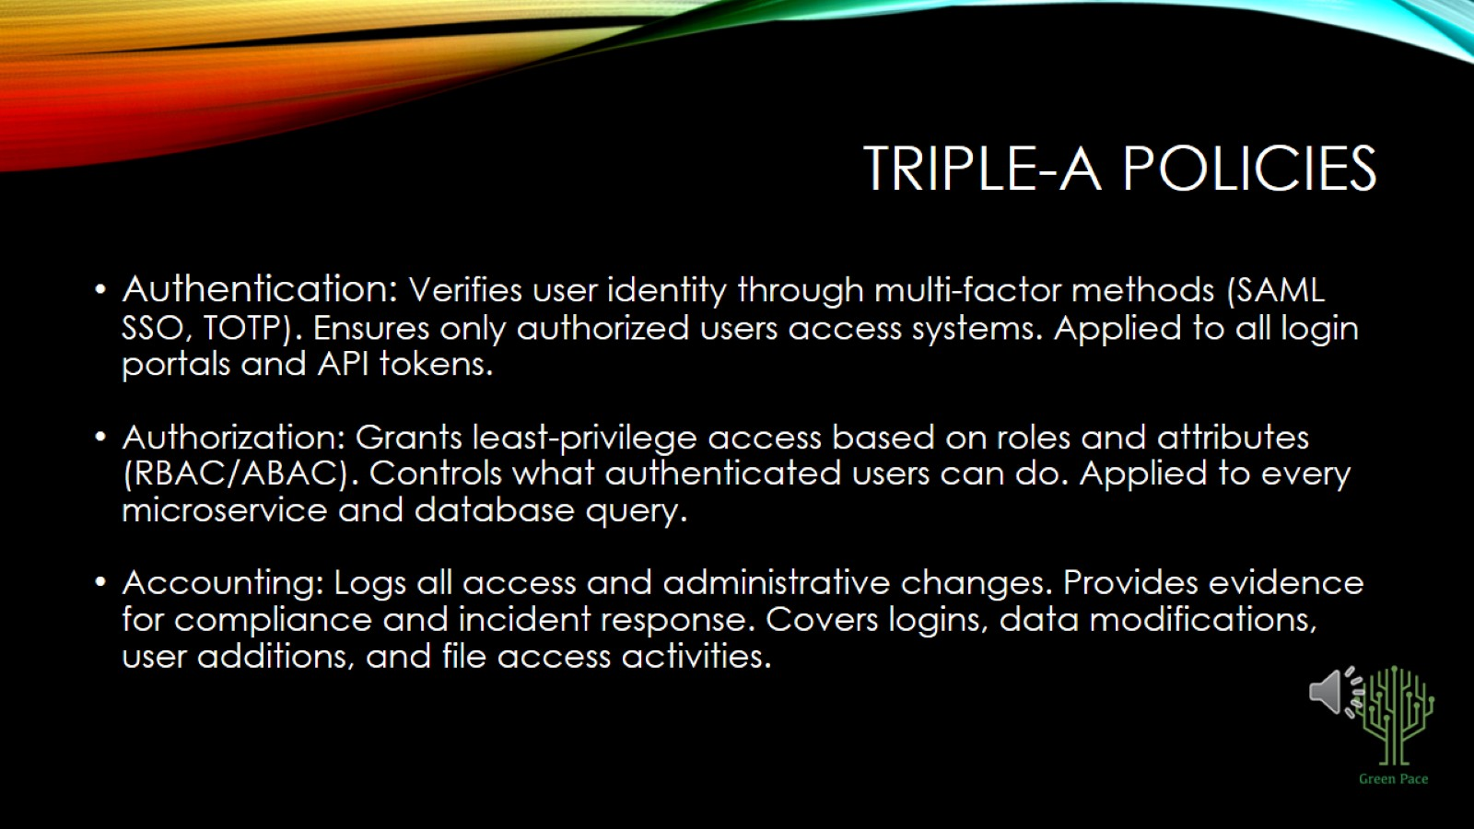
TRIPLE-A POLICIES

Slide 8
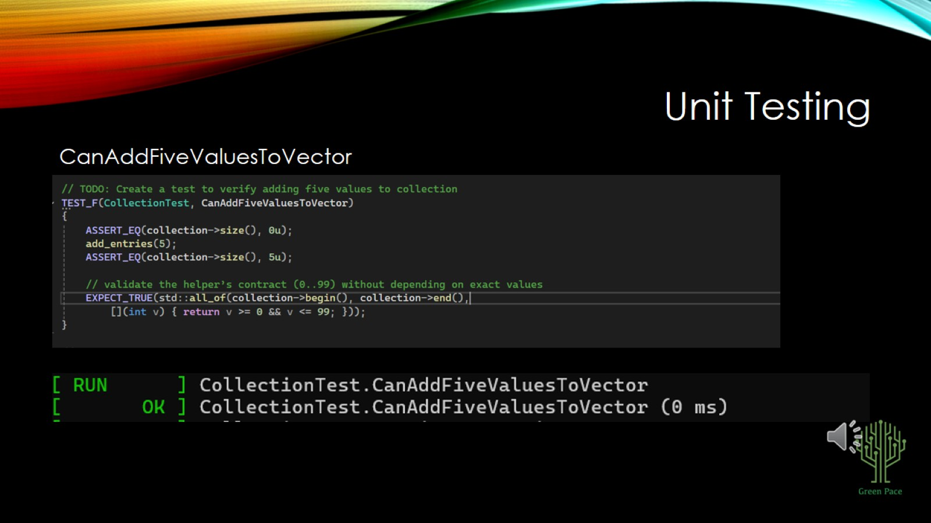
Unit Testing

Slide 9
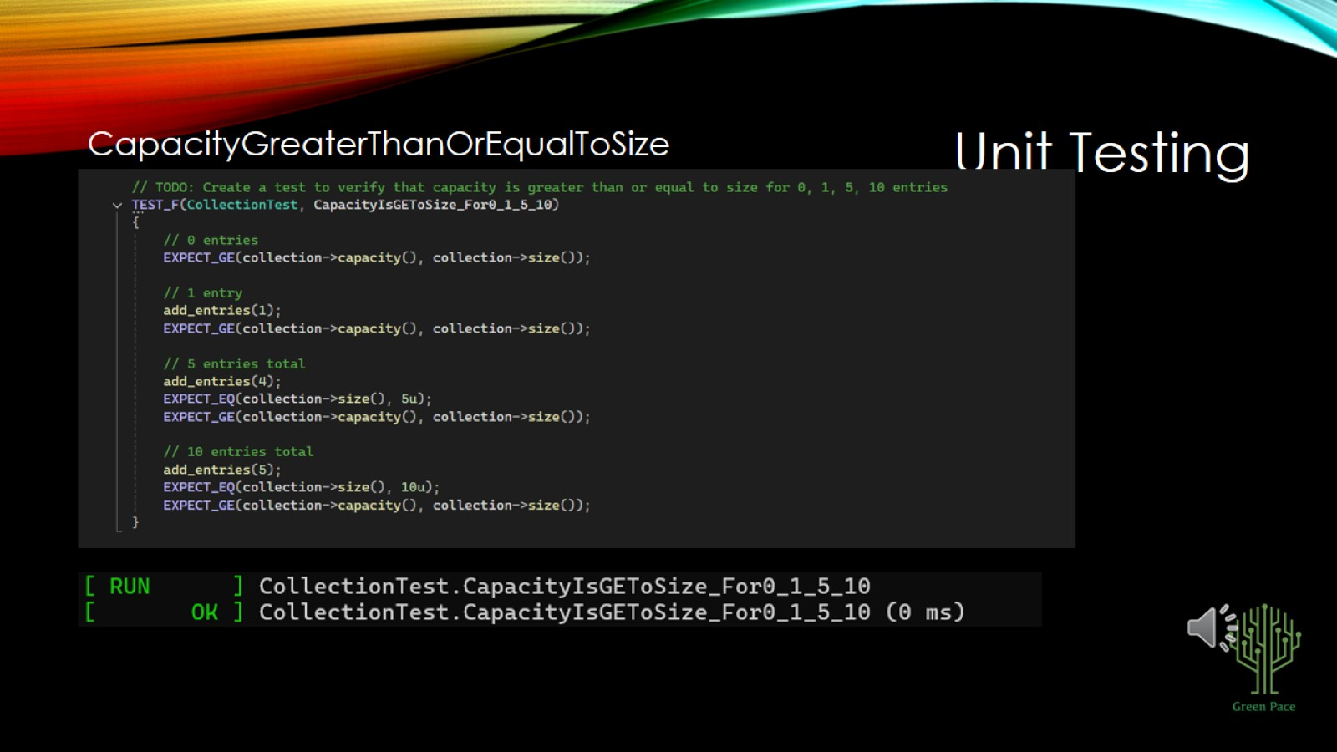
Unit Testing

Slide 10
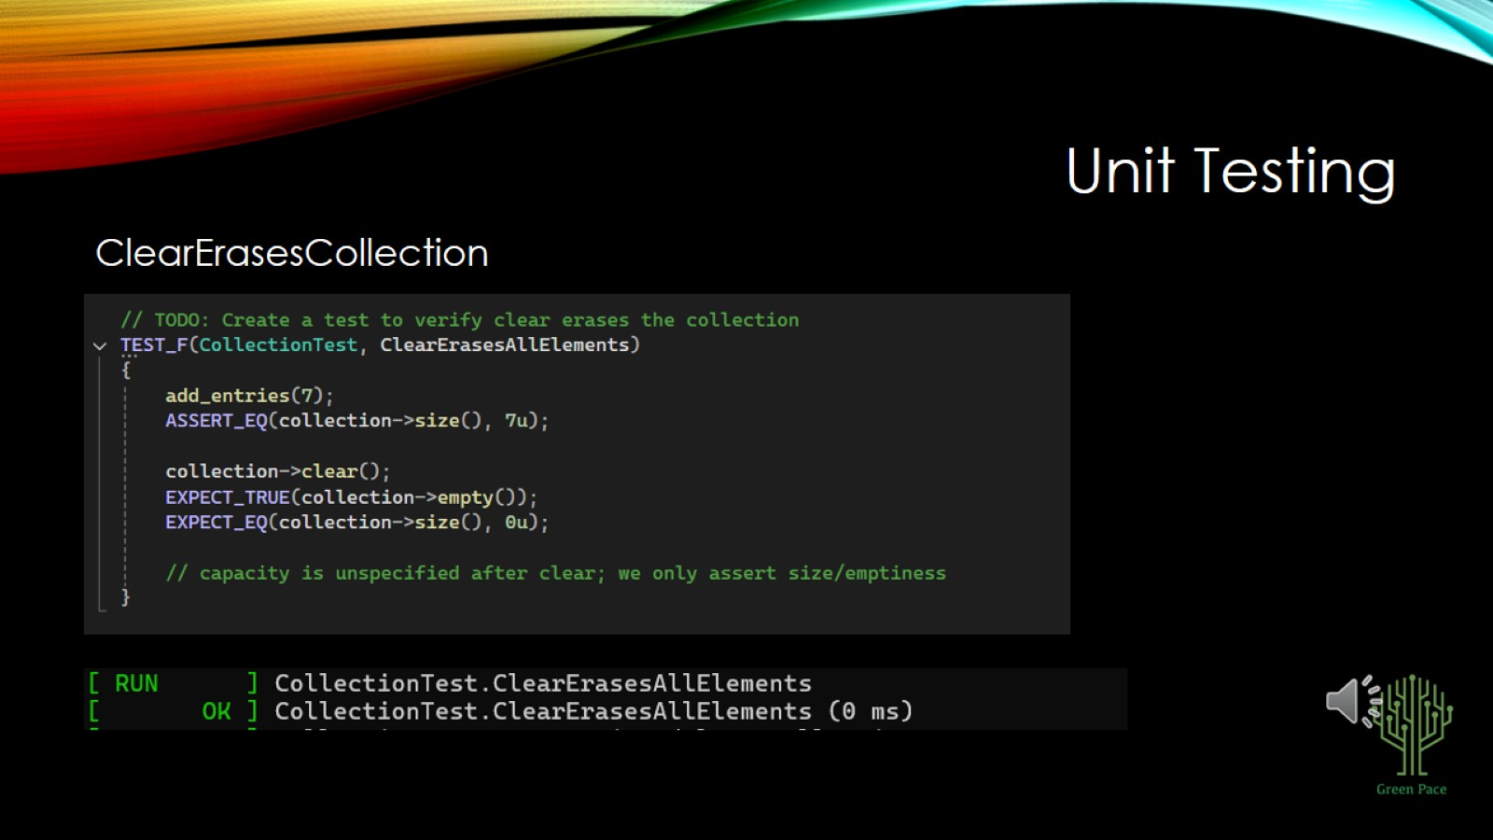
Unit Testing

Slide 11
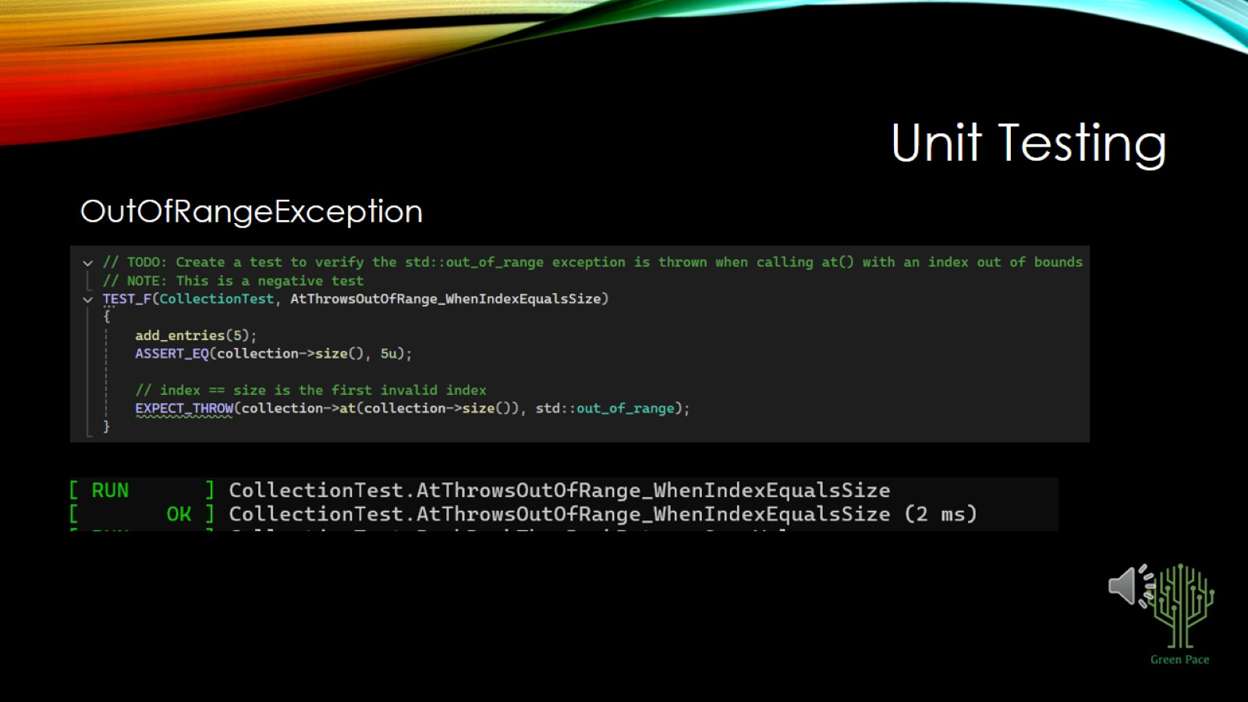
Unit Testing

Slide 12
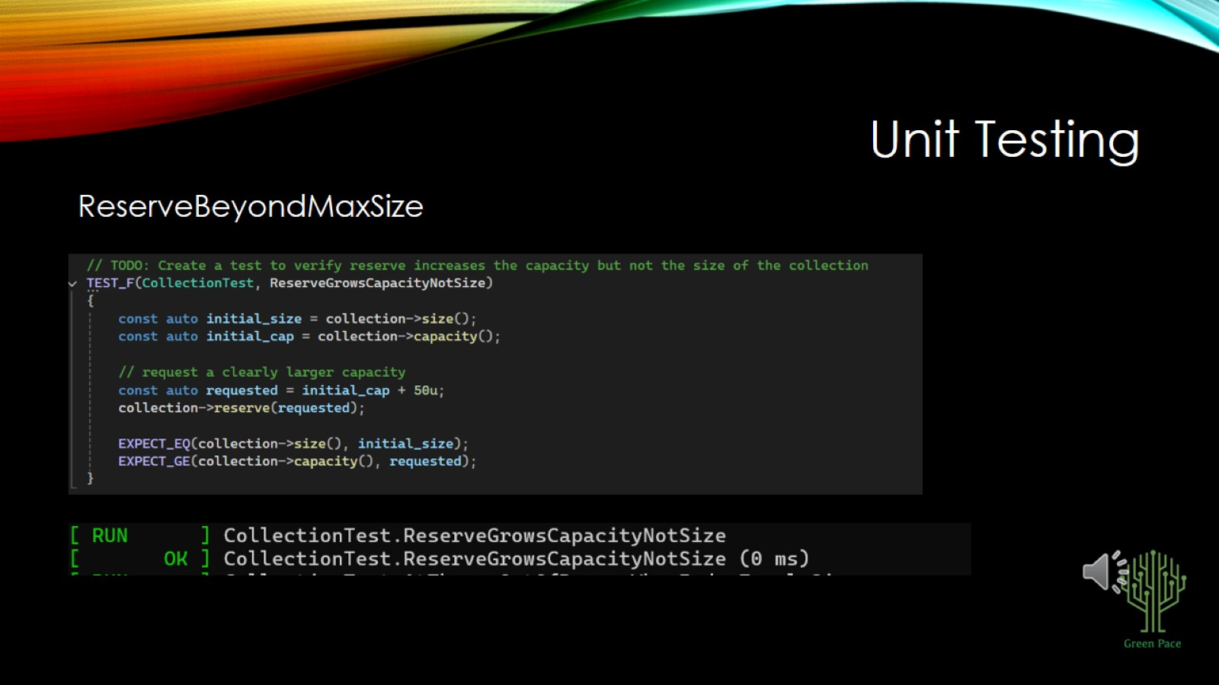
Unit Testing

Slide 13
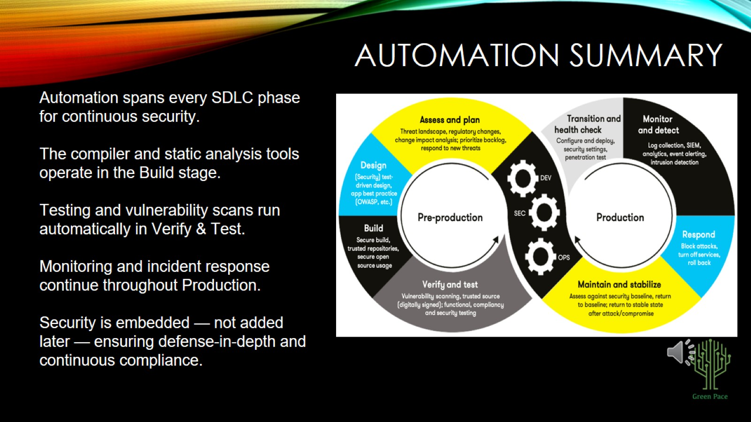
AUTOMATION SUMMARY

Slide 14
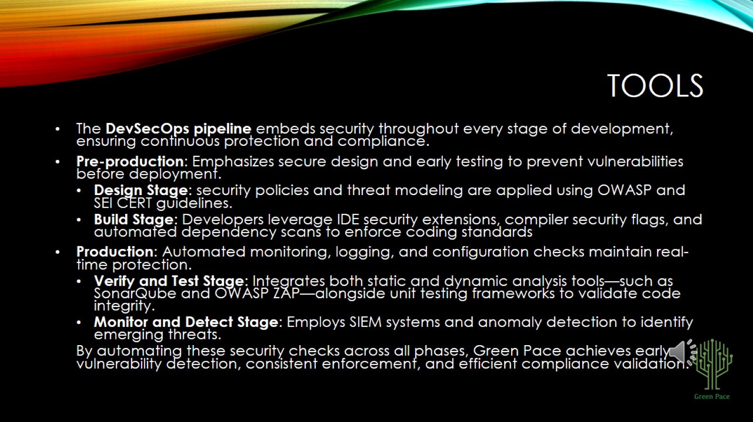
TOOLS

Slide 15
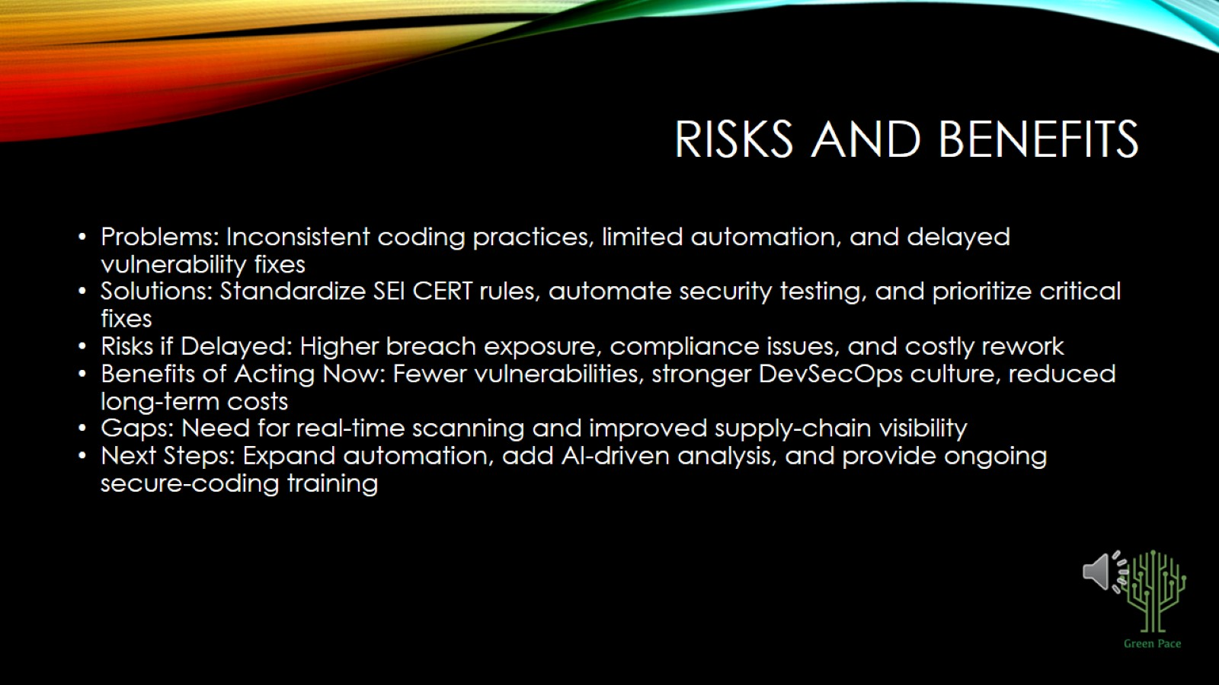
RISKS AND BENEFITS

Slide 16
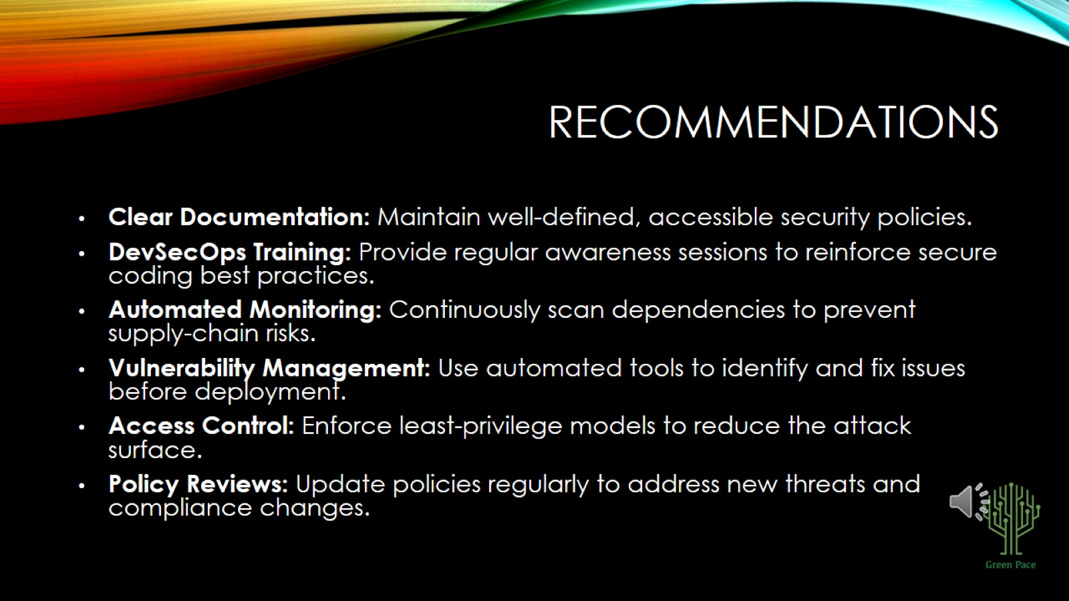
RECOMMENDATIONS

Slide 17
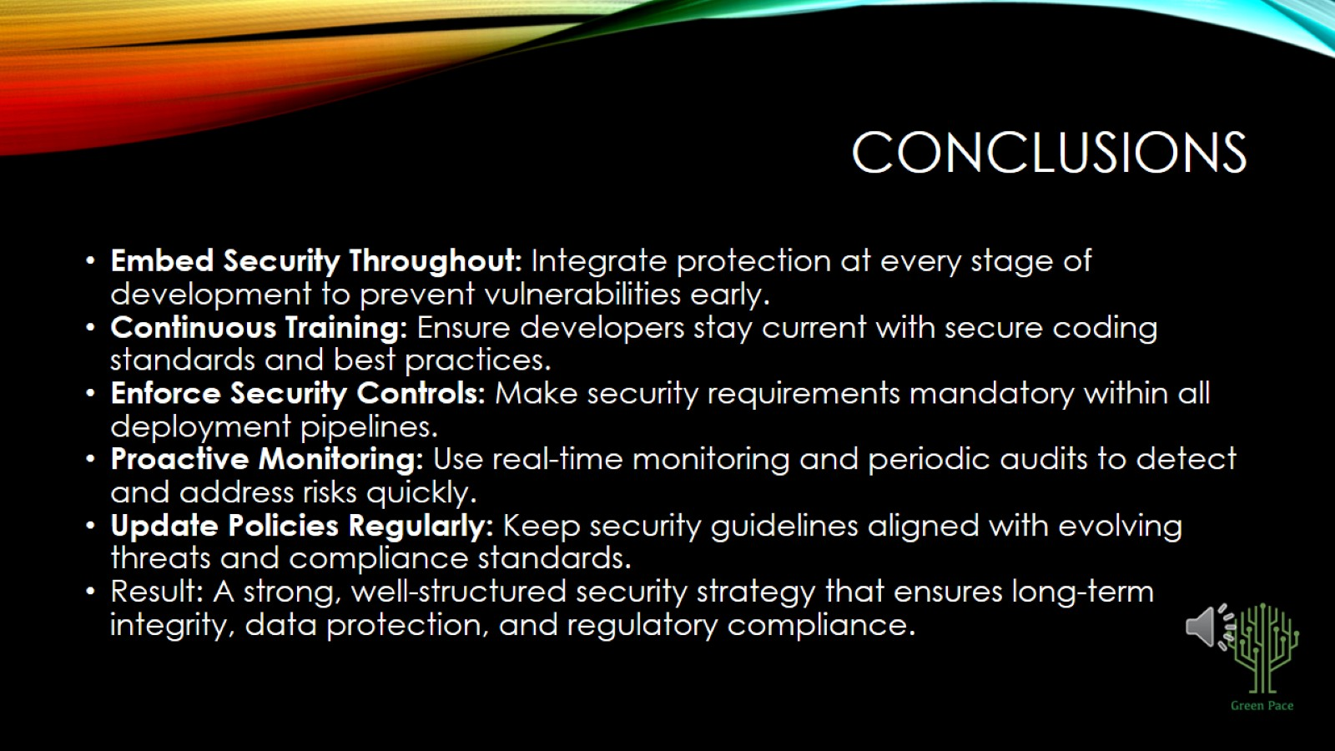
CONCLUSIONS

Slide 18
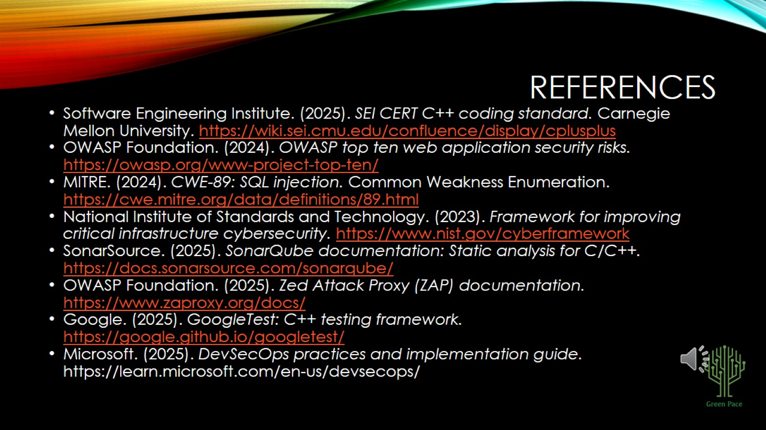
REFERENCES

